Slide 1

Event Processing Course
Event Patterns
(relates to chapter 9)

Slide 2
Lecture outline
About patterns
The notion of pattern
Pattern types
Patterns in FFD
Some code examples

Slide 3


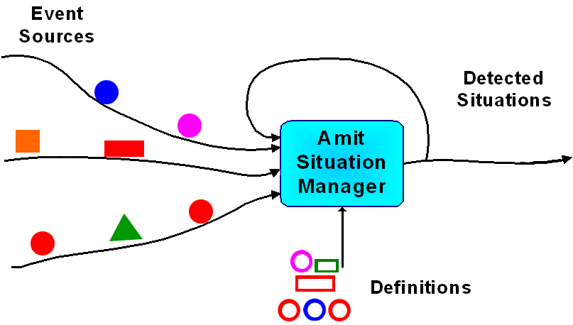

The many faces of patterns in event processing
And leave this one for another opportunity
Say a few words about this one
Software Engineering Design Patterns
Business User Patterns
We’ll start with this one
We’ll concentrate on this one
Event processing function patterns
Pattern in the “pattern detecting” meaning

Slide 4
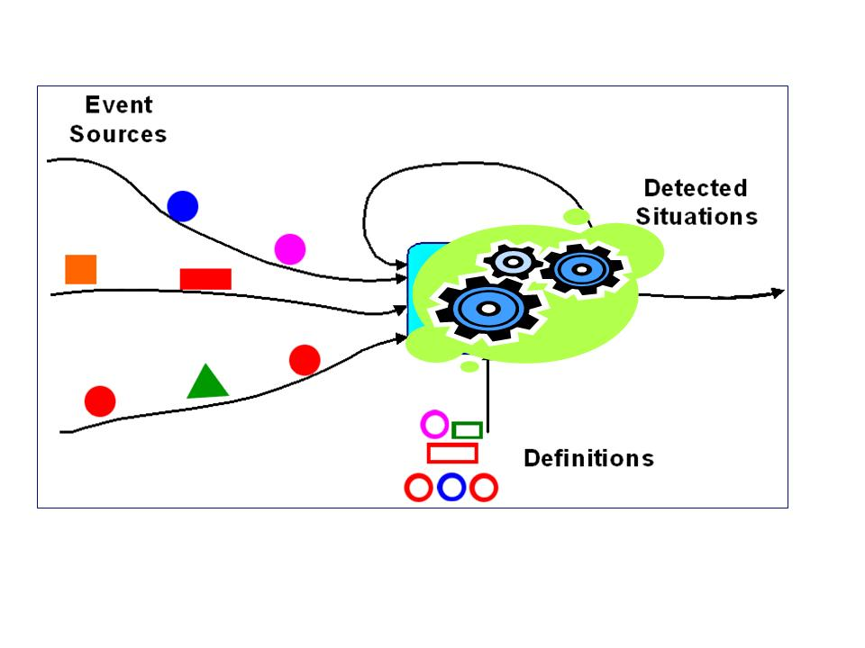
Event processing patterns – the idea

Slide 5
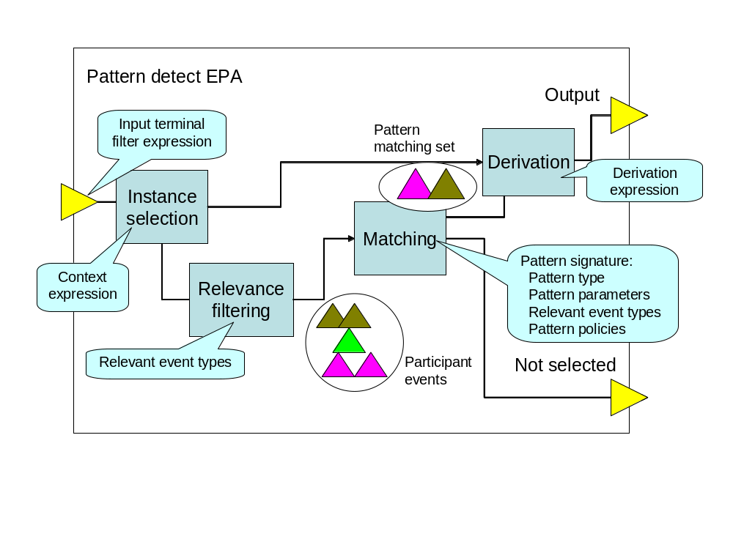
The EPA picture

Slide 6
EPA signature
The EPA signature consists of
<EPA identifier, EPA type, context, IET, OET, relevance assertion, pattern signature, derivation expression>
Where:
EPA identifier is a unique name for the EPA instance
EPA type: one of {filtering, transformation, pattern matching}
Context: The set of criteria to partition the events of the input event types among the EPA instances.
IET: a collection of input event types that the EPA receives from producers, channels or other EPAs
OET: a collection of output event types derived by the EPA, and routed to channels, other EPAs or consumers.
Relevance assertion: an assertion that is used to filter in the events instance in IET that are relevant for this specific EPA instance
Pattern signature is defined in the next slide and defines the pattern logic.
Derivation expression: Creation of the derived events.

Slide 7
Pattern signature
EVENT PATTERN
An event pattern is a template specifying one or more combinations of events. Given any collection of events, you may be able to find one or more subsets of those events that match a particular pattern. We say that such a subset satisfies the pattern
The pattern signature is formally defined as a tuple
<pattern type, relevant event types, pattern parameters and assertions, policies>,
PATTERN TYPE
The pattern type is a label that determines the meaning and intention of the pattern and specifies the particular kind of matching function to be used.
RELEVANT EVENT TYPES LIST
The relevant event types list is a list of event types that forms part of the pattern matching function. The order of these event types has importance for some pattern functions.
Some pattern types require additional values to be provided in the form of pattern parameters.
PATTERN PARAMETERS
Pattern parameters provide additional values used in the definition of the pattern function. The parameters that may be specified, and their meanings, vary depending on the pattern type.
PATTERN POLICY
A pattern policy is a named parameter that disambiguates the semantics of the pattern and the pattern matching process.

Slide 8
An example
Pattern name: Manual Assignment Preparation
Pattern Type: Relative N highest
Context: Bid Interval
Relevant event types: Delivery Bid
Pattern parameter: N = 5; value = Ranking
Cardinality: Single deferred

Slide 9
Pattern types
Pattern
Logical
Operators
Threshold
Subset
Selection
Modal
Temporal
Spatial
Spatio
Temporal

Slide 10
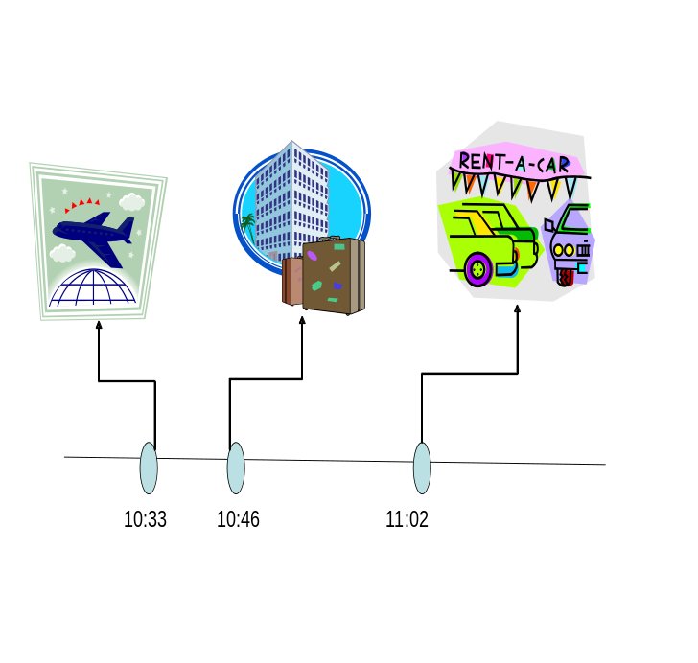
Logical operators
all: The all pattern is satisfied when the relevant event set contains at least one instance of each event type in the participant set
all: RET = {ET1…,ETn}; PS  MS = {E1,…,En}. The all pattern type is a function, where (E1…En) ∈ MS iff ∀i: ETi ∈ PET: ∃Ei ∈ MS, such that: Type (Ei) = ETi
any: The any pattern is satisfied if the relevant event set contains an instance of any of the event types in the participant set
any: RET = {ET1… ETn}; PS  MS = {E}. The any pattern type is a function, where E ∈ MS iff ∃i: ETi ∈ RET: such that: Type (E) = ETi.
Absence: The absence pattern is satisfied when there are no relevant events
absence: (RET = {ET1…ETn}; RS  MS = { }. The absence pattern type is a function, where PS = ∅, i.e. there are no relevant events of any of the types in RET.

Slide 11
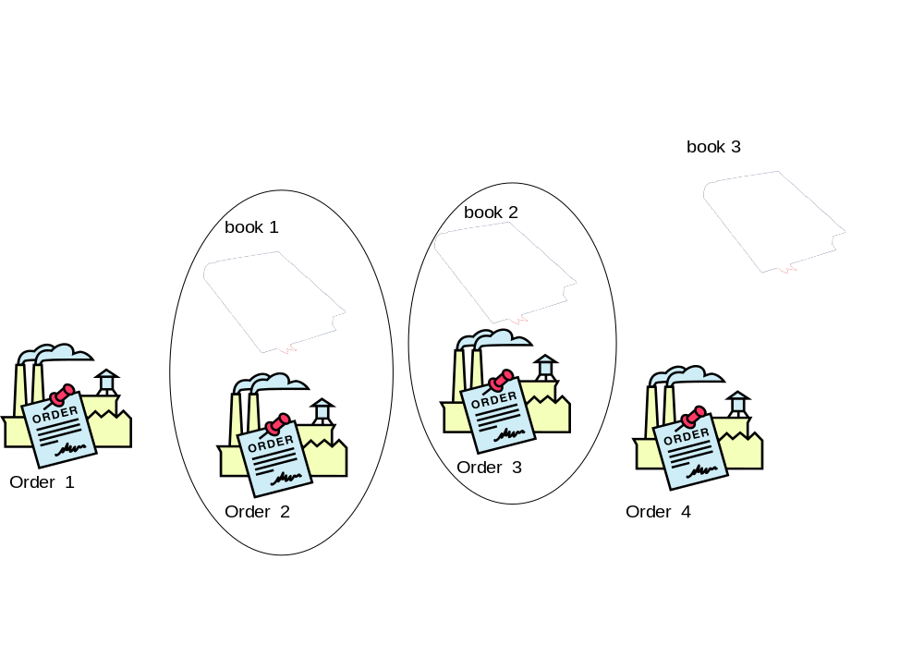
The not selected terminal example
Events are emitted on the not selected terminal if they are not selected by any matching set.

Slide 12
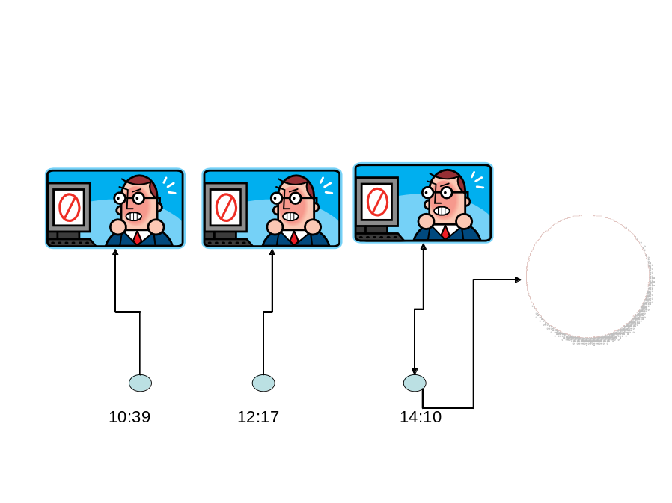
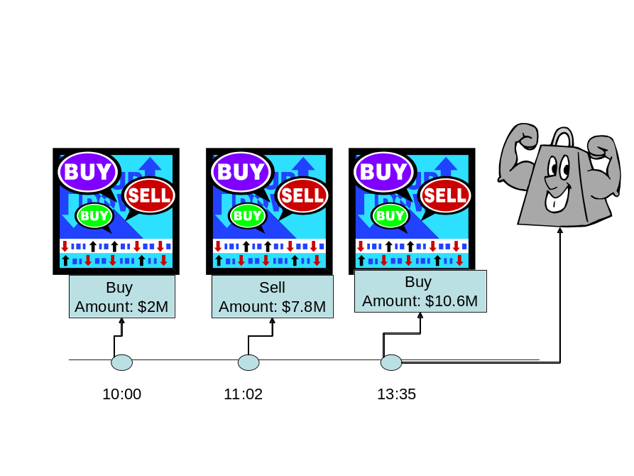
Threshold patterns
The count pattern is satisfied when the number of instances in the relevant event set satisfies the count threshold assertion.
The value max pattern is satisfied when the maximal value of a specific attribute over all the relevant events satisfies the value max threshold assertion
The value min pattern is satisfied when the minimal value of a specific attribute over all the relevant events satisfies the value min threshold assertion.
The value average pattern is satisfied when the value of a specific attribute, averaged over all the relevant events, satisfies the value average threshold assertion.

Slide 13
Threshold patterns definitions
Threshold pattern (PS, Threshold aggregate type pattern, binary operation, attribute name, threshold )  MS = PS iff the assertion: (aggregate type [attribute name] (PS), binary relation, threshold) is evaluated to true, where Aggregate types are: {count, value max, value min, value average, functor} and binary relations are {>, <, =, ≥, ≤, ≠}.

Slide 14
Subset selection patterns
The relative N highest values pattern is satisfied by the events which have the N highest value of a specific attribute over all the relevant events, where N is an argument.
  relative N highest value pattern [attribute]: (PS = {E1…Em})  MS, where >> is a descending order of the events in PS by the value of attribute, and Ei ∈ MS iff its position in >> ≤ N.
The relative N lowest values pattern is satisfied by the event which has the minimal value of a specific attribute over all the relevant events
  relative N lowest value pattern [attribute]: (PS = {E1…Em}) MS, where >> is an ascending order of the events in PS by the value of attribute, and Ei ∈ MS iff its position in >> ≤ N.

Slide 15
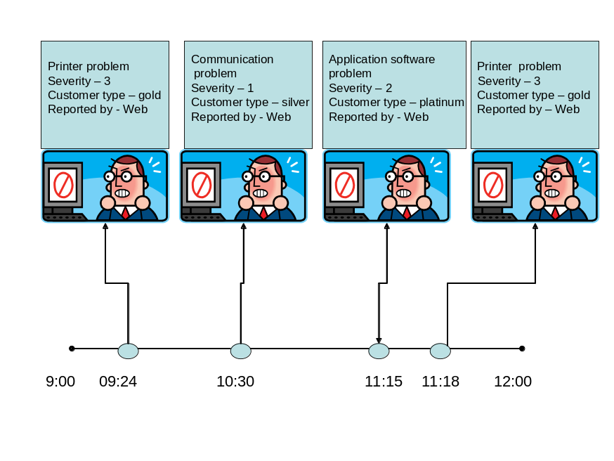
Modal patterns
The always pattern is satisfied when all the relevant events satisfy the always pattern assertion
  always pattern [assertion]: (PS = { E₁…E_{m} })  MS, returns the entire RS iff ∀i: assertion (E_{i}) is evaluates to true
The sometimes pattern is satisfied when there is at least one relevant event that satisfies the sometimes pattern assertion
  sometimes pattern [assertion]: (PS = { E₁…E_{m} })  MS, returns the entire RS iff ∃i: assertion (E_{i}) is evaluates to true.

Slide 16
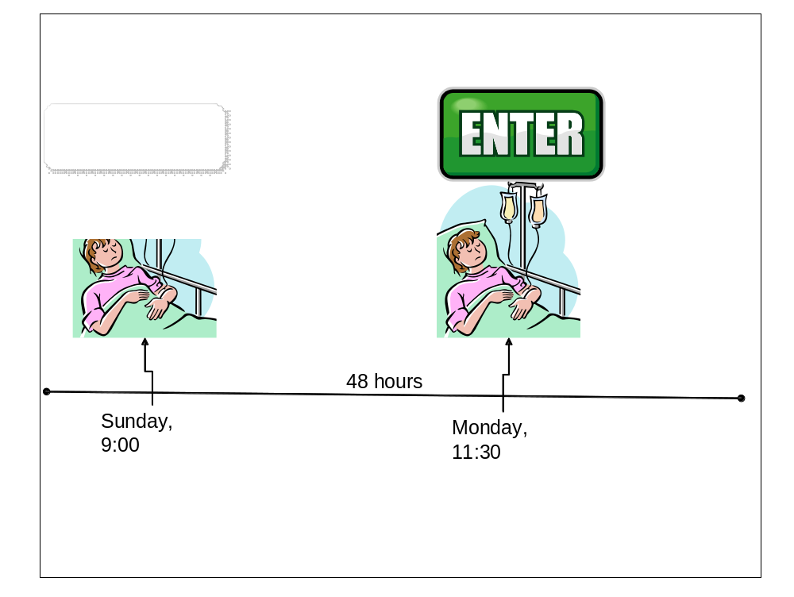
Dimensional patterns – temporal
The sequence pattern is satisfied when the relevant event set contains at least one event instance for each event type in the participant set, and the order of the event instances is identical to the order of the event types in the participant set.
  sequence pattern: RET = {ET₁,…,ET_{n}} PS  MS = {E1,…,En}. The sequence pattern type is a function, where ∀i: ET_{i} ∈ RET: ∃Ei ∈ PS, such that: Type (E_{i}) = ET_{i}, and ∀i, j: i > j IFF ETi >>ETj , where >> is a ascending order of the events according to the pattern order policy

Slide 17
Trends patterns
The increasing pattern is satisfied by an attribute A if for all the relevant events, e1 << e2 ⇒ e1.A < e2.A
The decreasing pattern is satisfied by an attribute A if for all the relevant events, e1 << e2 ⇒ e1.A > e2.A
The stable pattern is satisfied by an attribute A if for all the relevant events, e1 << e2 ⇒ e1.A = e2.A
The non increasing pattern is satisfied by an attribute A if for all relevant events e1 << e2 ⇒ e1.A ≥ e2.A
The non decreasing pattern is satisfied by an attribute A if for all relevant events e1 << e2 ⇒ e1.A ≤ e2.A
The mixed pattern is satisfied by an attribute A, if the relevant event set contains event instances e1, e2, e3, e4 such that: e1 << e2 and e1.A < e2.A and e3 << e4 and e3.A > e4.A

Slide 18
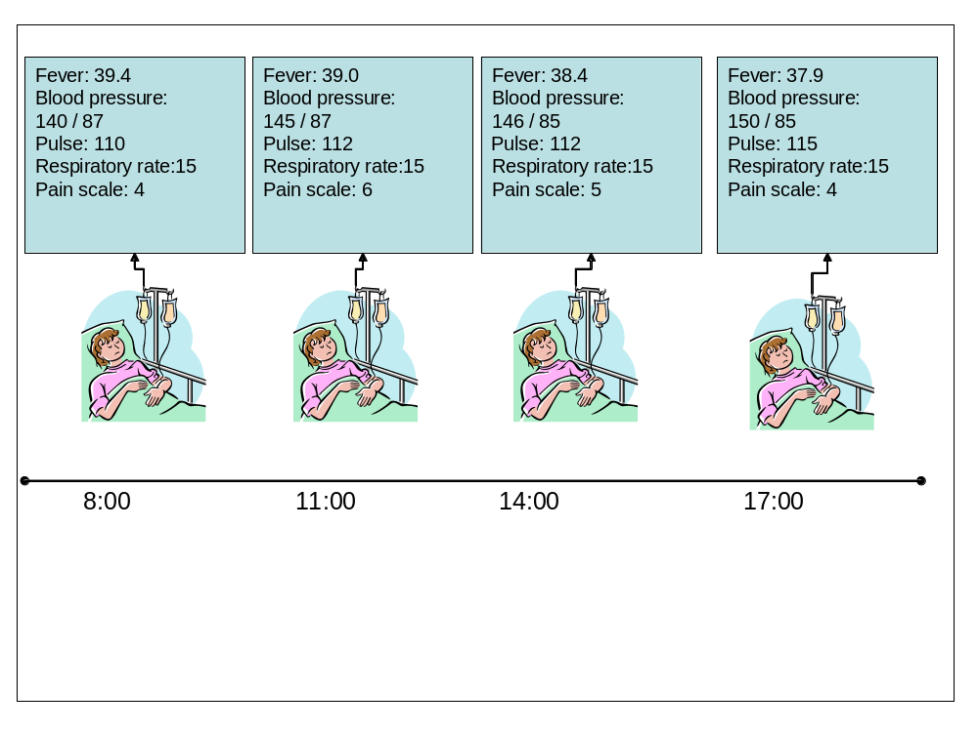
Trends pattern examples
Fever – decreasing
Blood pressure:
  Systolic – increasing
  Diastolic – non increasing
Pulse – non decreasing
Respiratory rate: stable
Pain scale: mixed

Slide 19
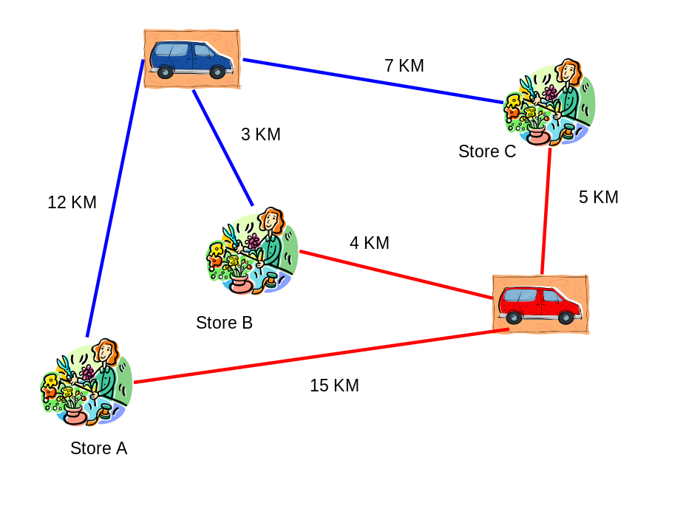
Spatial patterns
The min distance pattern is satisfied when the minimal distance of all the relevant events from a given point satisfies the min distance threshold assertion
The max distance pattern is satisfied when the maximal distance of all the relevant events from a given point satisfies the max distance threshold assertion
The average distance pattern is satisfied when the average distance of all the relevant events from a given point satisfies the average distance threshold assertion

Slide 20
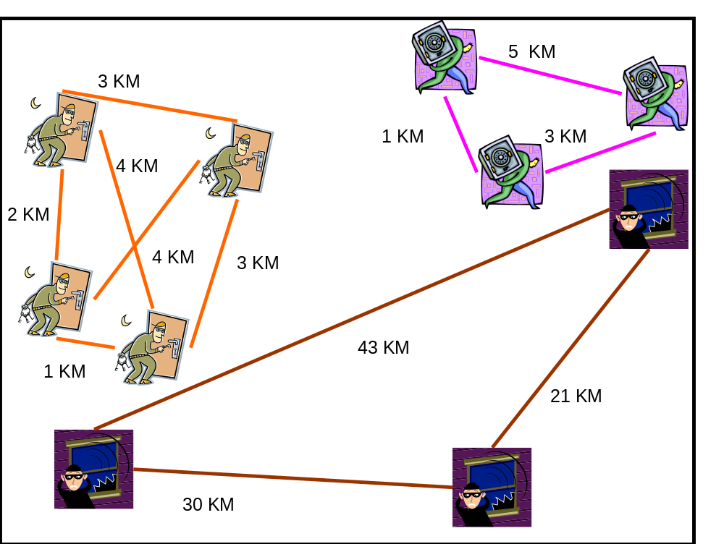
Relative distance patterns
The relative min distance pattern is satisfied when the minimal distance between any two relevant events satisfies the min distance threshold assertion.
The relative max distance pattern is satisfied when the maximal distance between any two relevant events satisfies the max threshold assertion
The relative average distance pattern is satisfied when the average distance between any two relevant events satisfies the relative average threshold assertion

Slide 21
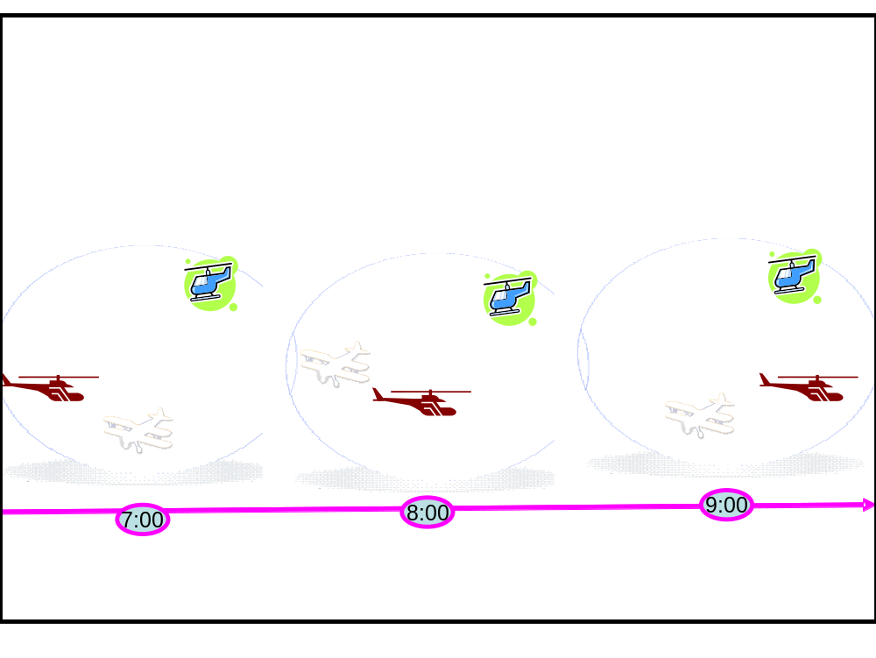
Spatiotemporal patterns
The moving in a constant direction pattern is satisfied if there exists a direction from the set {north, south, east, west, northeast, northwest, southeast, southwest} such that for any pair of relevant events e1, e2 we have e1 << e2 ⇒ e2 lies in that direction relative to e1.
The moving in a mixed direction pattern is satisfied if none of the eight moving in a consistent direction patterns is satisfied
The stationary pattern is satisfied if the location of all relevant events is identical
The moving toward pattern is satisfied when for any pair of relevant events e1, e2 we have e1 << e2 ⇒ the location of e2 is closer to a certain object then the location of e1.

Slide 22

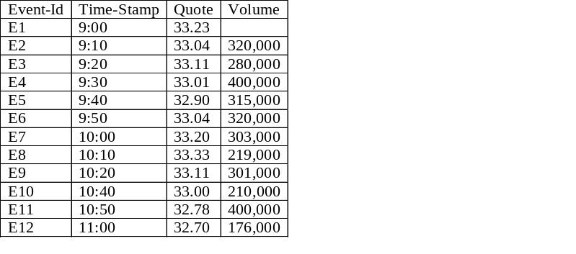
A simple example: heavy trading scenario
Given:
  A stream of events of a single type, about the activity in the stock market for a certain stock.
  An event is produced every 10 minutes when there is trade in the stock.
  Each event consists of: quote (current stock-quote), volume (an accumulated volume of traded events within these 10 minutes).
  A selection specification: “trigger an automatic trade program if the volume exceeds 300,000 3 times within an hour; pass as an argument the last quote and the sum of the 3 volume values”.
Why defining patterns is not that easy? Because we need to tune up the semantics
How many times the trade programming is triggered ;
Which arguments are used in each triggering?

Slide 23
Pattern policies
Evaluation policy—This determines when the matching sets are produced.
Cardinality policy—This determines how many matching sets are produced within a single context partition.
Repeated type policy—This determines what happens if the matching step encounters multiple events of the same type.
Consumption policy—This specifies what happens to a participant event after it has been included in a matching set.
Order policy—This specifies how temporal order is defined.

Slide 24
Evaluation policy
An evaluation policy is a semantic abstraction that determines when the matching process is to be evaluated.
The evaluation policy lets you choose whether a Patter detect agent generates output incrementally, or only at the end of the temporal context. The two policies are:
Immediate—The pattern is tested for each time a new event is added to the participant event set.
Deferred—The pattern is only tested for when the agent's temporal context partition (window) closes.

Slide 25
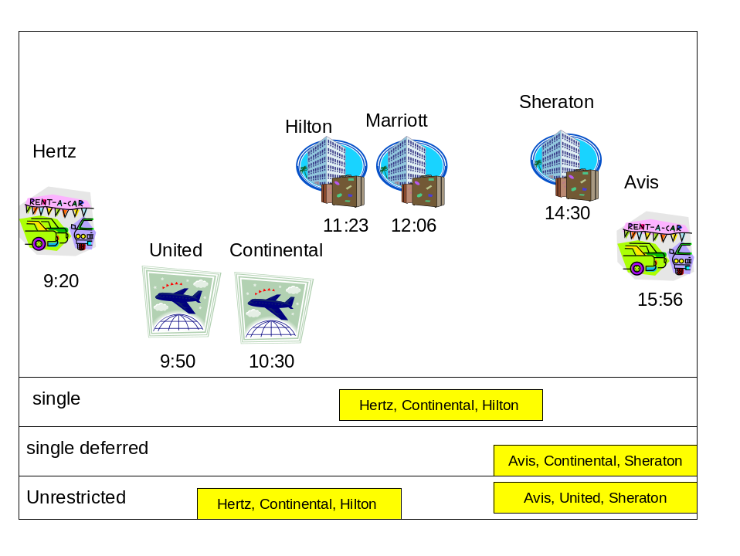
Cardinality policies
A cardinality policy is a semantic abstraction that controls how many matching sets are created. The possible policies are: single, unrestricted and bounded.
The various policies are:
Single—Only one matching set is generated. When this has been done no further action is performed within this context partition, so no more matching sets are generated.
Unrestricted—Under this policy there are no restrictions on the quantity of matching sets that can be generated.
Bounded—This policy specifies an upper bound on the number of matching sets that can be generated within a context partition. The Pattern detect agent continues generating matching sets until it reaches this bound.

Slide 26
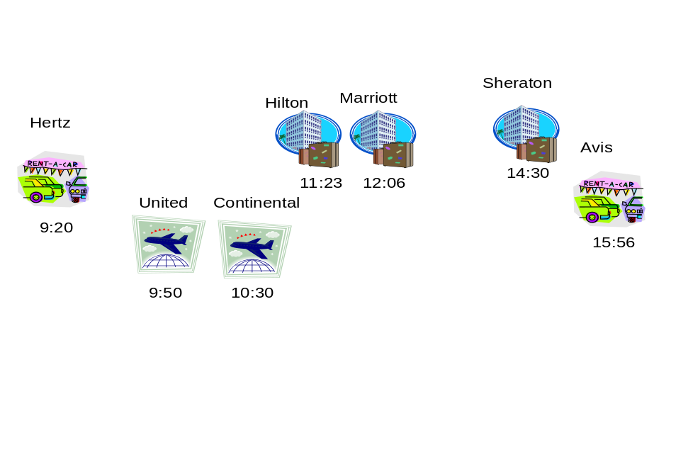
Repeated type policies
A repeated type policy is a semantic abstraction that defines the behavior of a Pattern detect agent when an excess type condition occurs. The possible policies are: override, every, first, last, with maximal value, with minimal value.
Override The participant event set keeps no more instances of any event type than the number implied by the relevant event types list. If a new event instance is encountered and the participant set already contains the required number of instances of that type, then the new instance replaces the oldest previous instance of that type.
Every: Every instance is kept in the participant event set, so that all possible matching sets can be produced.
First Every instance is kept in the participant event set, but only the earliest instances of each type are used for matching.
Last Every instance is kept, but only the latest instances of each type are used for matching.
With maximal value <attribute name> Every instance is kept, but only the event or events with the maximal value of the specified attribute are used for matching.
With minimal value <attribute name> Every instance is kept, but only the event or events with the minimal value of the specified attribute are used for matching.

Slide 27
Consumption policies
A consumption policy is a semantic abstraction that defines whether an event instance is consumed as soon as it is included in a matching set, or whether it can be included in subsequent matching sets. Possible consumption policies are: consume, reuse and bounded reuse.
The consumption policies are quite straightforward:
Consume—Under this policy each event instance is removed from the participant event set once it has been included in a matching set. This means that it cannot take part in any further matching for this particular pattern within the same context.
Reuse—under this policy, an event instance can participate in an unrestricted number of matching sets.
Bounded reuse—under this policy, you can specify the number of times that an event can be used in matching sets for this particular pattern within the same context.

Slide 28
Order policies
An order policy is a semantic abstraction that defines the meaning of the << temporal order of the event instances in the participant event set. The possible policies are: by occurrence time, by detection time, by user-defined attribute, or by stream position.
The order policy is applicable to all temporal or spatiotemporal patterns. The possible policies are:
By occurrence time—The order of events in the participant event set is determined by comparing their occurrence time attributes, so that the order reflects the order in which the events happened in reality (as accurately as the temporal granularity allows).
By detection time—The order of events in the participant event set is determined by comparing their detection time attributes, that is the order in which events are detected by the event processing system. Note that this order may not be identical to the order in which events happened in reality.
By user-defined attribute—Some event payloads contain a timestamp, sequence number or some other attribute that increases over time, and this can be used to determine the order. For example the Delivery Request events in the Fast Flower Delivery application could be ordered using their Delivery Time attribute.
By stream position—In this case the order to be used is the order in which the events are delivered to the event processing agent from the channel that feeds it. Some channel implementations are designed so that this order is the same as the order in which events were delivered to the channel

Slide 29
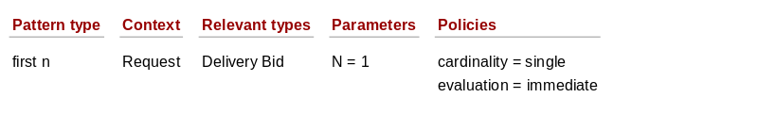
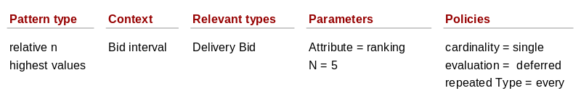
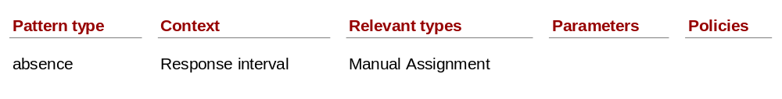
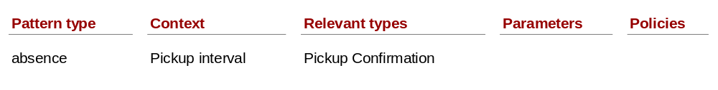
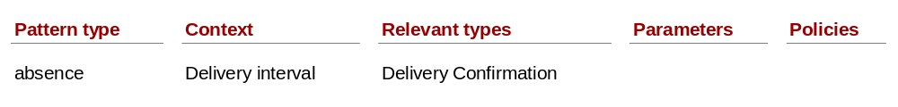
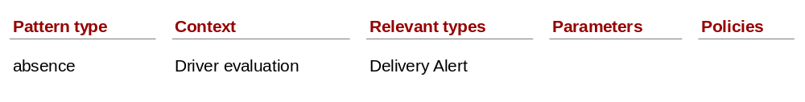
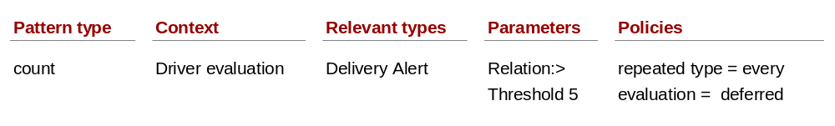
FFD patterns
Automatic assignment
Manual assignment preparation
Assignment not done
Pickup Alert
Delivery Alert
Ranking Increase
Ranking Decrease

Slide 30
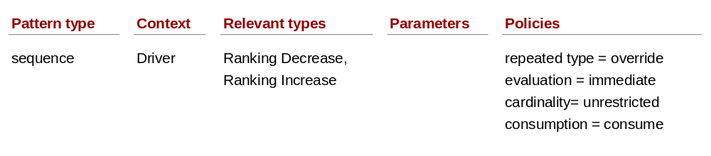
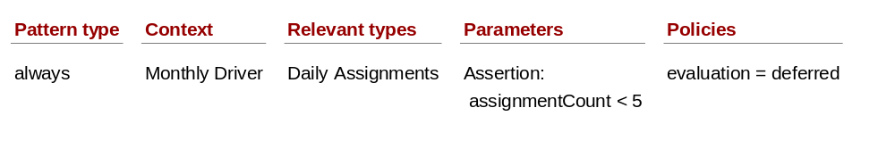
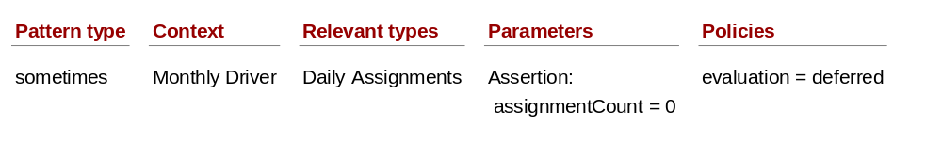
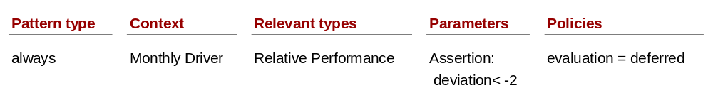
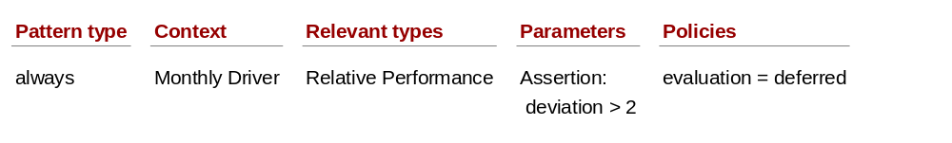
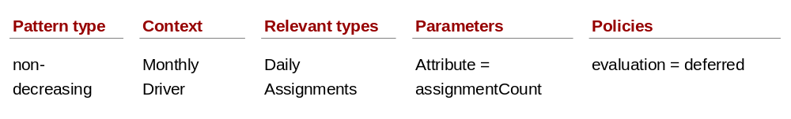
FFD patterns (cont).
Improving note
Permanent weak driver
Idle driver
Consistent weak driver
Consistent strong driver
Improving driver

Slide 31
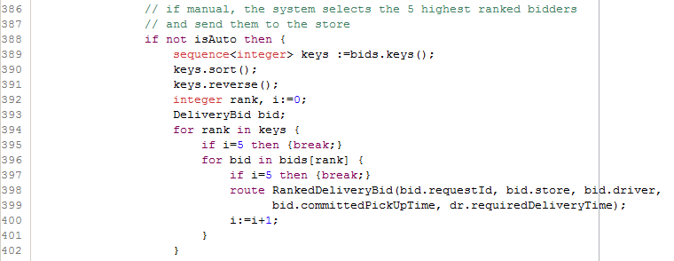
Apama example

Slide 32
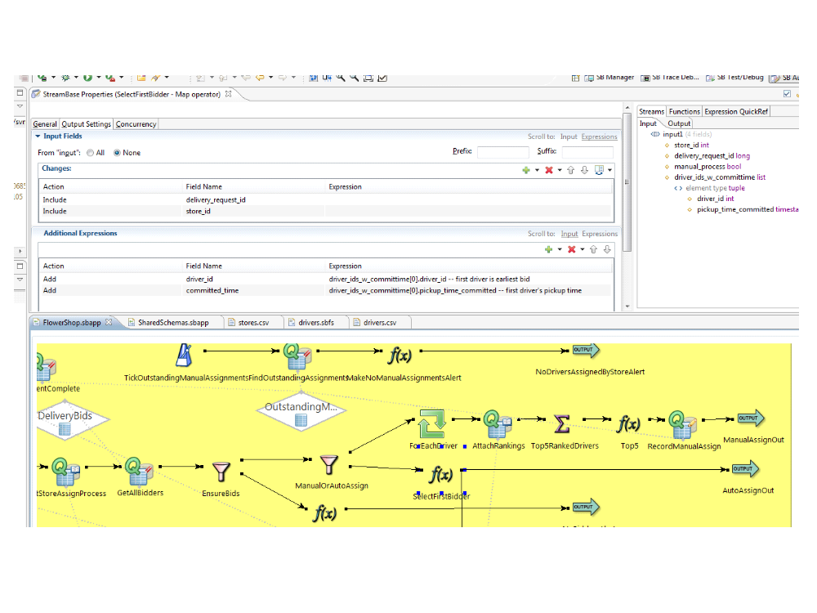
Streambase example

Slide 33
Esper example
/**
* No bid after 2 mins of a request
*/
insert into AlertW(requestId, message, driver)
select d.requestId, "no bidder", ""
from pattern[
every d=DeliveryRequest -> (timer:interval(120 sec) and not
DeliveryBid(requestId = d.requestId))
];

Slide 34
What have we learned
Pattern in general
Event pattern notions
Pattern types
Patterns in FFD
Some code examples

